Slide 1
Sensory Ecology:
The Ümwelt Concept
Notes:
Teacher Notes: Remind students about the resource navigation activity in Part 1, to help them focus on the ümwelt concept (the topic of this presentation)

Slide 2
Vocabulary
Sensory Ecology:
The study of how an organism’s perception
of the world around them influences their
distribution and abundance.
Ümwelt:
The world as perceived by an organism,
based on its sensory abilities
Notes:
Teacher Notes: this is a reiteration of the vocabulary word "ümwelt" and its definition. Ask the students to write this down in their notes (as a cue that they should begin taking notes on the upcoming info). Remind them that “distribution” refers to where an organism is located, and “abundance” refers to how many organisms there are.

Slide 3
What Senses Do We Know About?
Non-Human Senses
Human Senses
Ultra-violet Vision
Chemoreception
Thermoperception
Magnetoperception
others?
Sight
Hearing
Smell
Taste
Touch
Notes:
Teacher Notes: Ask for a show of hands: who has heard of any of these non-human senses before? Can students provide examples of organisms that have them?

Slide 4
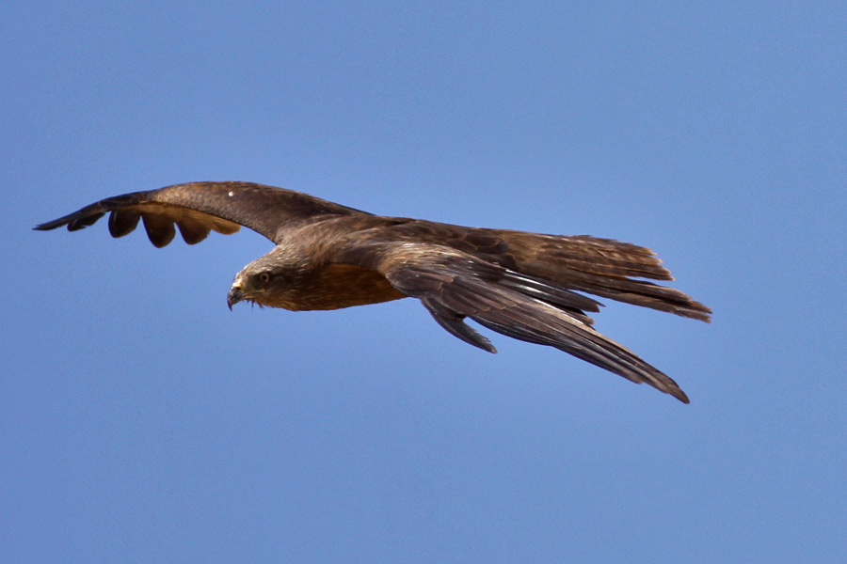
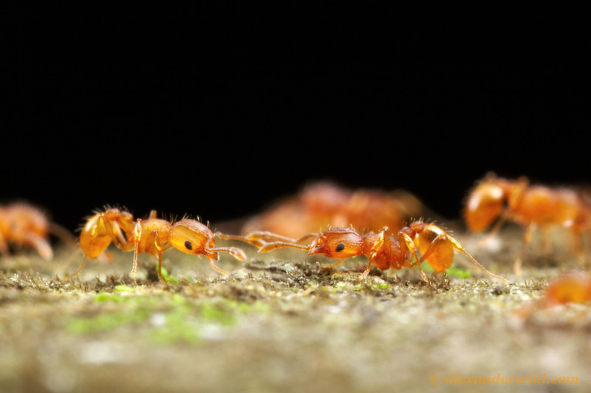
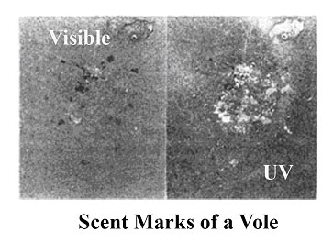
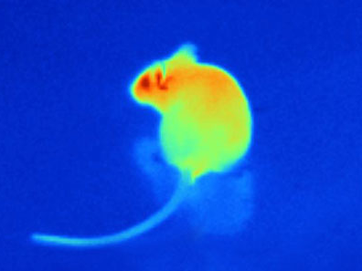
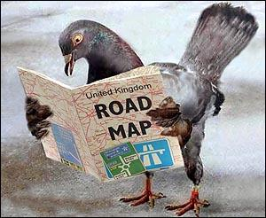
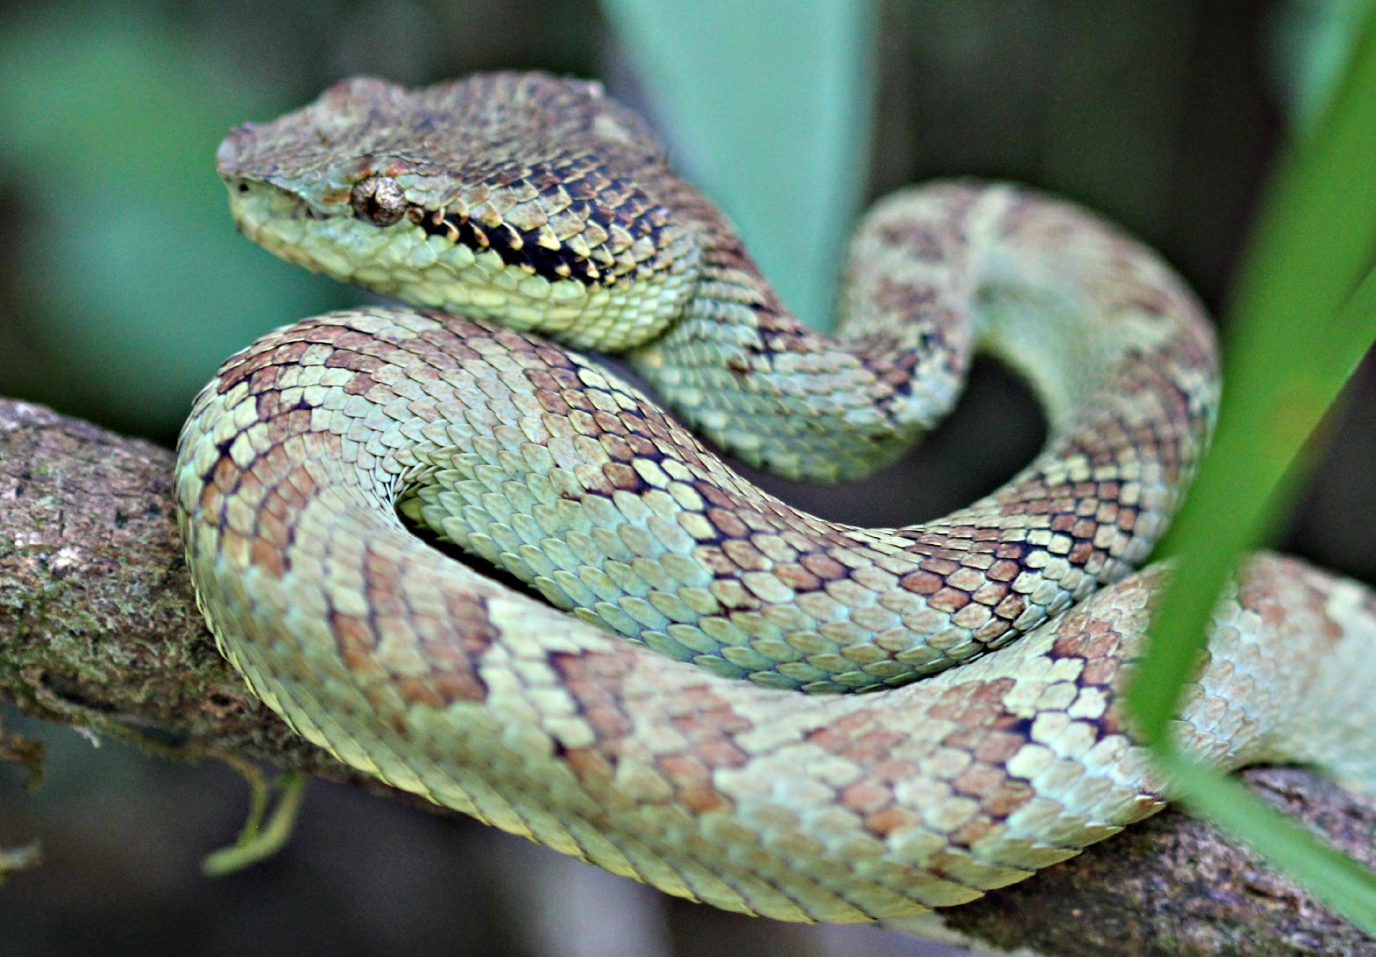
Ants communicating using chemoreception
Kites use UV vision when hunting
Pit vipers create heat images using thermoperception
Homing pigeons use magnetoreception, among other senses, when navigating
Notes:
Teacher Notes: These images provide quick examples of non-human senses.
Clockwise from top left:
-- Example of ultraviolet vision: Voles and other small rodents use urine to create scent markings as they move through their habitats. Although these markings are not something humans can easily see (left side of the photo, in the visible light spectrum), they CAN by seen by certain predatory birds like kestrels and kites (right side of the photo, UV range in the light spectrum). These birds will use the visible markings to locate their prey.
-- Example of chemoreception: Ants use specialized organs or antennae to detect pheromones (chemicals used in signaling) secreted by other ants. This sense is called chemoreception and, as shown in this picture, it can help two ants who meet to distinguish whether or not they are from the same colony (same family). If the two ants are related (same colony), they remain peaceful, but if they are from different colonies, they might attack each other.
-- Example of thermoperception: Pit vipers can sense heat, which allows them to locate warm-bodied prey even in the dark. This is helpful when they are chasing after prey that live underground in tunnels, or when hunting at night. Here, the picture on the left reconstructs a heat image of a mouse, and the picture on the left is of a pit viper.
-- Example of magnetoreception: Homing pigeons are among many organisms that sense and use Earth’s magnetic fields in order to navigate. Homing pigeons were bred to find their way home over hundreds of miles, and also use the sun, odors, and visual landmarks to orient themselves. Other organisms that have magnetoreception capabilities include bees and sea turtles.

Slide 5
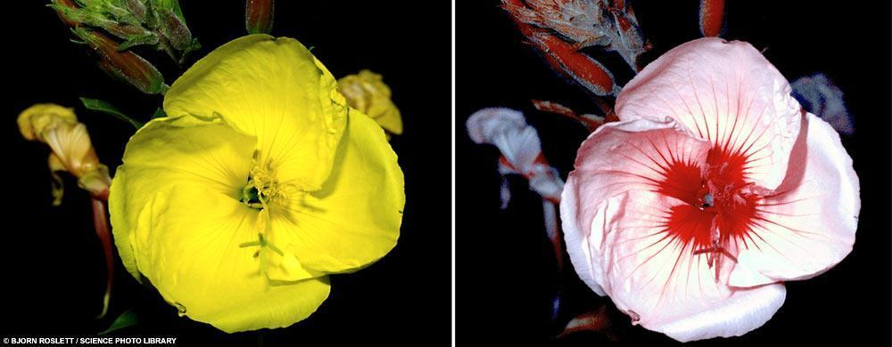
Human View
Bee View
Notes:
Teacher notes: At the top of this slide is a graphic of the light spectrum, clearly showing that the "visible light" spectrum is just a small portion of what possibly exists in the environment. On the bottom of this slide are side-by-side pictures of a flower as seen by a human versus by a bee; bees have ultraviolet vision, and therefore can see the nectar guides on the petals.
Teacher should make the point: some organisms have senses like ours, but with a greater range. For example, like us, bees have a sense of vision, but their range is different than ours.

Slide 6
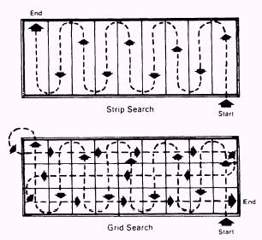
Dog (left) and Human (above) search patterns are influenced by different dominant senses
Notes:
Teacher Notes: The image on the left is an enhanced photograph of a bloodhound’s path navigating by scent to a pheasant, illustrating a weaving behavior used for tracking.
Ask: This is another example of an organism with a sense that humans have, but its range is different. What's going on here?
Make the point: Here's an example of an organism with a stronger sense of smell compared to humans, and that influences its (resource acquisition) behavior. A dog follows a scent by weaving back and forth across the path left by the thing it is searching for.
Compare this to the image on the right, which diagrams the way human as sight-dominant organisms (instead of smell-dominant) might search for an object with unknown location. In thorough searches, humans often systematically cover an area by moving along visual strips or grids rather than tracking something directly.

Slide 7
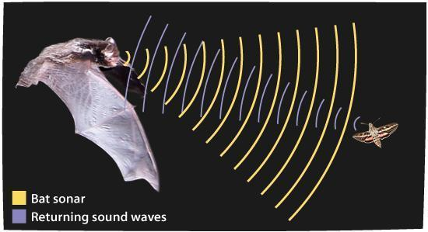
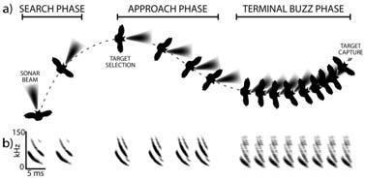
Notes:
Teacher Notes: These images showcase a bat navigation strategy: echolocation (making pictures with sound!). The top image illustrates how echolocation works, with a bat emitting high pitched sounds and listening for the echoes back from objects that the sound hits. The bottom diagram shows how a bat’s flight path and the frequency of its echolocation sounds change as it searches, pursues, and captures insect prey.
Mention: depending on species, bats can also navigate using magnetoperception (cues from Earth’s magnetic field), thermoperception (vampire bats can perceive and navigate using infrared radiation, i.e. heat), and olfactory (smell) cues.
Make the point: An organism's ümwelt, a result of all its senses combined, is one of the main drivers of its behavior. Take note -- there are a lot of ümwelts out there that are different than ours as humans!
Ask: Why might ecologists need to understand the ümwelts of organisms, in particular how they might differ from the ümwelts of humans? Create a brainstorm of class responses.

Slide 8
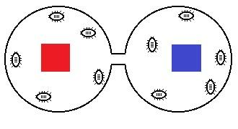
An Experiment with Roly Poly Pill Bugs
Notes:
Teacher Notes: This is a diagram from a roly poly classroom experiment (which "habitats" do they prefer?) in which students decided to use colored blocks as treatments in each habitat (would the bugs prefer a particular color?).
Explain: It turns out that anything involving color, although it may seem like a logical way to differentiate habitats because they look pretty different to us humans, is not useful in the context of roly poly pill bugs, because these bugs are colorblind
Make the point: ecologists need to consider the ümwelts of organisms in order to ask good scientific questions about them.

Slide 9
Question Session:
Why might people in general need to understand the ümwelts of other organisms?
How can human activities influence the ümwelts of other organisms?
Notes:
Teacher Notes: This slide introduces themes that students will be working with for the remainder of Part 2 and on into Part 3. Get the class active by having them consider these questions as a think-pair-share, and then contribute responses to a class brainstorm.
Suggested line: Now that we have talked about why scientists need to understand ümwelts for their research, let’s take a minute to think about… (first question above).

Slide 10
Human-created pollution can be problematic for organisms because of how it is perceived
Notes:
Teacher Notes: This is an illustration of plastic bags floating among jellyfish, part of an outreach initiative by a sea turtle protection group from South Carolina.
Make the point: humans create many incredible things, but they can also create harmful pollution that other organisms interact with. In this case, the plastic bags are not distinguishable by sea turtles from their natural food source. Sea turtles can swallow plastic bags, which can then clog their digestive systems.

Slide 11
Renewable Energy… and Birds
Notes:
Teacher Notes: This is a photograph of a wind turbine with flocks of birds flying by/perching.
Ask: has anyone heard of issues with wind turbines injuring flying birds?
Explain: Despite the fact that these are huge structures that seem very obvious to us, wind turbines still cause bird (and bat) fatalities. Wind turbines are put where wind currents are strong, which is often also in the migratory pathway of certain bird species. People have tried all sorts of ways of preventing collisions between birds and turbines, such as brightly colored paint

Slide 12
Taking Ümwelt into Account
Notes:
Teacher Notes: This is a photograph of a technician installing an ultrasonic sound emitter on a wind turbine to deter birds.
Make the point: urban/energy development is another way in which humans impact ecosystems. Human activities can negatively impact other organisms, but sometimes we can take steps to prevent our developments from harming them if we understand an organism's ümwelt and how to communicate or influence its behavior.

Slide 13
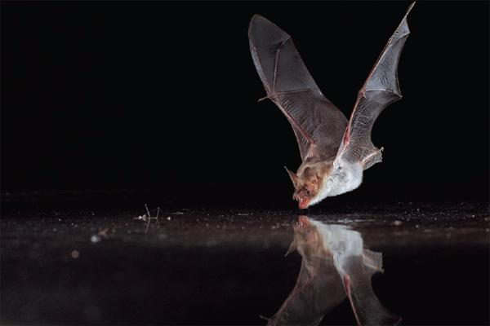
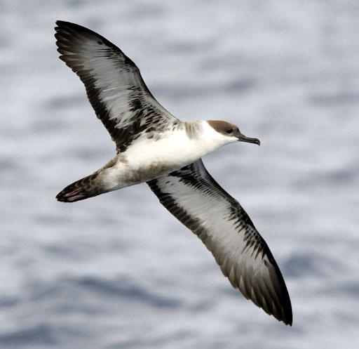
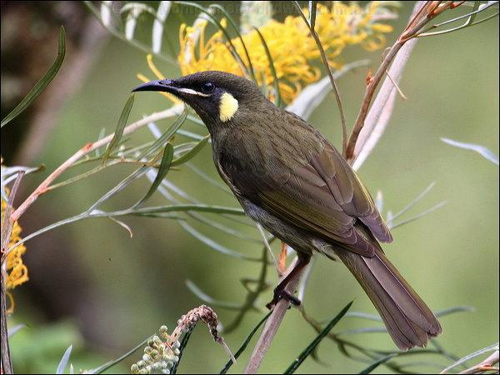
Now You Try!
Mystery Scenarios Activity:
In groups, read through the scenario provided and the follow-up questions
Brainstorm answers to the questions
Be prepared to share your thoughts with the class!
Notes:
Teacher Notes: Use this slide to help transition to Part 3 of the lesson -- the small groups activity. Along the right are representative images of the three organisms mentioned in the scenarios: (from top to bottom) a bat, a shearwater, and a songbird.

Slide 14
Authors: Megan Mayo and Jan Ng
Graduate students at the University of California, Davis
Acknowledgments: This material is produced in conjunction with the Bodega Marine Laboratory, the University of California Davis, and the NSF Graduate K-12 CAMEOS program. The National Science Foundation (grant no. DGE-0841297 to Susan Williams and Bertram Ludaescher) supported this work. Additionally, the authors would like to thank Susan Williams, Jessica Bean, and Casey Peters.

Slide 15
References
Image: vole scent marks in UV, accessed on 21 August 2014
http://www.moremesa.org/wordpress/raptor-vision/
Image: black kite, accessed on 21 August 2014
http://andalucianguides.blogspot.com/2010_06_01_archive.html
Image: 2 ants communicating, accessed 21 August 2014
http://www.alexanderwild.com/Ants/Natural-History/Communication/i-2PDvbq7/A
Information: ants using chemoreception (Teacher’s Notes), accessed 21 August 2014
http://science.jrank.org/pages/450/Ants-Communication.html
Image: heat image of mouse, accessed 21 August 2014
https://www.sciencenews.org/article/pit-vipers-night-vision-explained
Image: pit viper, accessed 24 August 2014
http://commons.wikimedia.org/wiki/File:Malabar_pit_viper_silent_valley.jpg

Slide 16
References, continued
Image: homing pigeon, accessed 24 August 2014
http://alto-marketing.com/2013/09/20/the-biological-compass/
Information: magnetoreception, accessed 24 August 2014
multiple journal articles cited in http://en.wikipedia.org/wiki/Homing_pigeon
and in http://en.wikipedia.org/wiki/Magnetoception
Image: visible light spectrum, accessed on 18 April 2014
http://deserthighlandspr.com/wp-content/uploads/2013/02/Visible-spectrum.jpg
Image: primrose in ultraviolet light, accessed on 19 April 2014
Taken by Bjorn Roslett
http://ppu-s2-0910.blogspot.com/2009/08/how-insects-see.html
Image: bloodhound tracking-by-scent trail, accessed on 19 April 2014
http://www.newscientist.com/article/dn10810-unleash-your-inner-bloodhound--start-sniffing.html#.U1Ig_VfesTA
Image: bat echolocation, accessed on 19 April 2014
http://askabiologist.asu.edu/echolocation

Slide 17
References, continued
Image: bat flight path, accessed on 19 April 2014
http://www.batlab.umd.edu/project/melproject.html
Image: choice chamber, accessed on 28 July 2014 (and modified from)
http://www2.sluh.org/bioweb/apbio/labs/apl11.htm
Image: jellyfish and plastic bags, accessed on 19 April 2014
http://www.debordieuscute.org/photo-gallery/photo-gallery-3/
Image: birds and wind turbines, accessed on 19 April 2014
http://www.greenbuildinglawupdate.com/2013/12/articles/codes-and-regulations/federal/first-ever-criminal-prosecution-for-deaths-of-birds-by-wind-turbine/
Article: painting turbines (info in Teacher Notes), accessed on 19 April 2014
http://www.offshorewind.biz/2013/08/09/experiment-in-norway-painting-wind-turbines-to-avoid-bird-collisions/
Image: technician installing sound deterrent, accessed on 19 April 2014
http://users.humboldt.edu/joe/research.htm

Slide 18
References, continued
Image: bat flying over water, accessed on 28 July 2014
http://blogs.discovermagazine.com/notrocketscience/2010/11/02/how-bats-find-water-and-why-metal-confuses-them/
Image: shearwater, accessed on 28 July 2014
http://en.wikipedia.org/wiki/Shearwater
Image: Lewins Honeyeater songbird, accessed on 28 July 2014
http://birdway.com.au/meliphagidae/lewins_honeyeater/source/lewins_honeyeater_35966.htm

